Slide 1
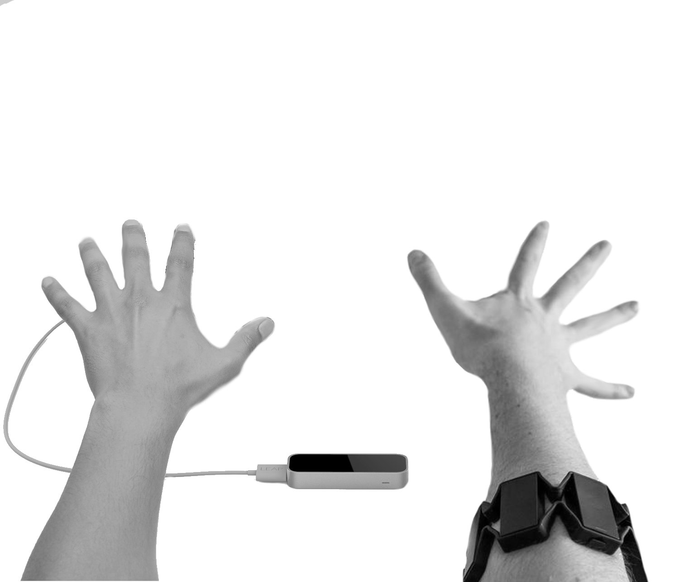

Emergent Gaming Technologies Week 10 - B: Evaluative Report
Evaluative Report

Slide 2
This lecture will cover
Emergent Gaming Technologies: Week 10-B
Topics
What to include on the Evaluative Report?
Critical evaluation of the chosen technology.
Critical evaluation of implemented mechanics.
A critical evaluation of the functionality of the artefact.
Obstacles faced
Marking Criteria

Slide 3
Evaluation of the chosen technology
Emergent Gaming Technologies: Week 10-B
Evaluate the overall performance of the chosen technology.
How difficult is to achieve the recommended set up?
How difficult it is to use the technology?
If you are using a physical gadget to store user input: How does it compare to traditional forms of input (keyboard and mouse).
Evaluate strengths and flaws of the chosen technology.
If you are developing an algorithm:
Evaluate its performance, how fast does it achieve the desired results.
How difficult would it be to implement your algorithm in a different project.
How can your algorithm improve Virtual Environment development workflow.

Slide 4
Implemented Mechanics
Emergent Gaming Technologies: Week 10-B
Provide a detailed evaluation of the core mechanics of your applications.
Provide relevant reasons to support the implementation of each of your core mechanics.
Explain how are you exploiting the potential of the chosen technology.

Slide 5
Performance of the artefact
Emergent Gaming Technologies: Week 10-B
Provide a detailed evaluation of the functionality of your application:
What works as intended?
What doesn’t work as planned? : Explain why.
How possible bugs can be fixed on future iterations of the project?
If you are aware of any existing issue MENTION IT!

Slide 6
Obstacles
Emergent Gaming Technologies: Week 10-B
Provide a detailed list of the problems you encountered during the development of your application.
For each problem, mention how did you solved it.
If the final delivery of your application contains an known problem, mention how it could be solve in future iterations of the project.

Slide 7
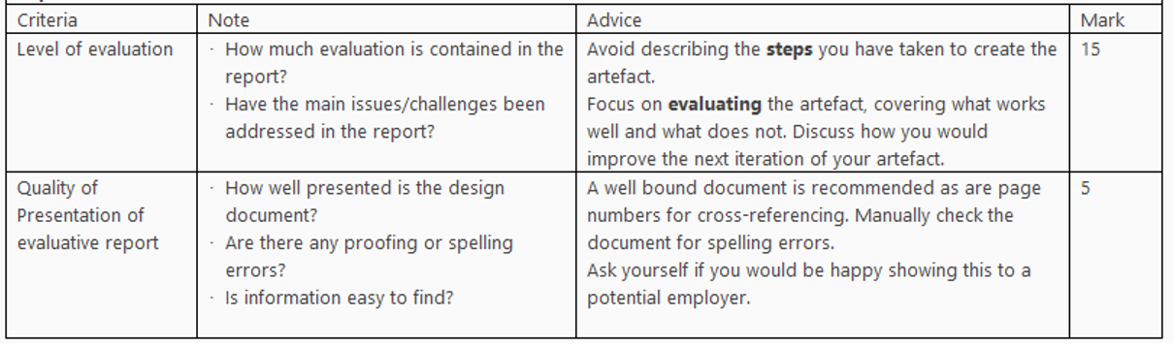
Marking Criteria
Emergent Gaming Technologies: Week 10-B

Slide 8
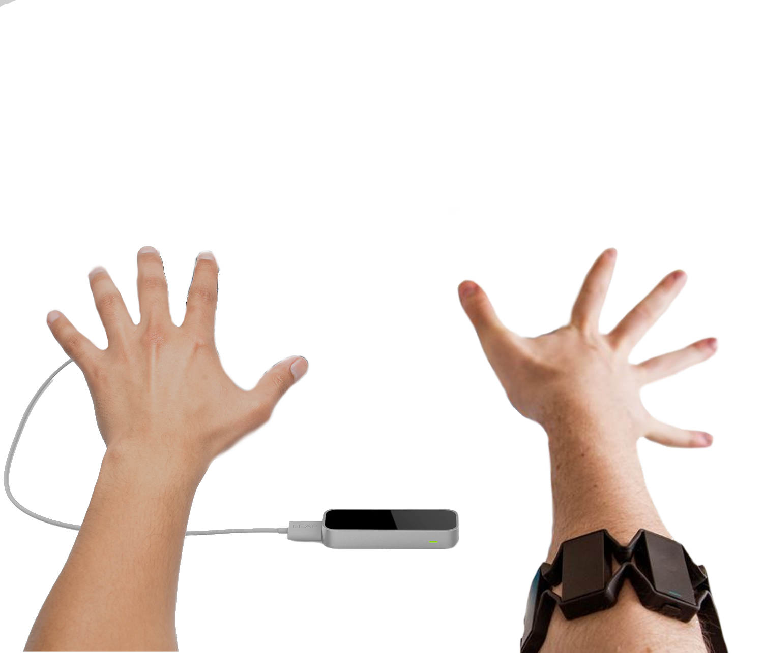
Questions?
Emergent Gaming Technologies: Week 10-B

